Slide 1


IBM University Engagement Project Submission
EcoGuardAI
AI-Powered Environmental Monitoring and
Risk Intelligence System

Slide 2

Project Tile – EcoGuardAI
Domain of Project – Environment / Sustainability / AI
Student Name | Recent Passport Photo | Email ID | Mobile number [WhatsApp]
KHILANKUMAR RAJPUT |  | tonystark882006@gmail.com | 96013 17824

Slide 3
Problem Statement
The Challenge:
Environmental conditions can change continuously, while traditional monitoring methods may rely on manual observation or isolated sensor readings. This makes it difficult to identify abnormal conditions, understand environmental risks, and respond quickly. Environmental data from multiple parameters can also be difficult to interpret without centralized monitoring and intelligent analysis. A system is therefore needed to continuously process sensor data, detect potential risks, and provide clear and timely insights for better decision-making.
The Objective: Build an AI-powered Environmental Monitoring and Risk Intelligence System that analyzes environmental sensor data and provides intelligent risk insights.
The solution should:
  Environmental Data Monitoring – Collect and process environmental sensor readings.
  Risk Detection – Identify abnormal or potentially hazardous conditions.
  AI-Powered Analysis – Use IBM Granite to analyze environmental conditions.
  Risk Classification – Convert analyzed conditions into understandable risk information.
  Real-Time Dashboard – Display sensor readings and AI-generated insights.
  Live Data Updates – Provide continuous dashboard updates using SSE.
  Alert Generation – Provide warnings when potential environmental risks are detected.
  IoT Readiness – Support MQTT-based ingestion for future real-world sensor integration.

Slide 4
Proposed Solution:
EcoGuardAI:
The proposed solution is an AI-powered Environmental Monitoring and Risk Intelligence System designed to analyze environmental sensor data and provide intelligent risk insights. EcoGuardAI processes environmental readings through a backend system, analyzes the conditions using IBM Granite, and presents the results through a real-time monitoring dashboard.
The system provides:
  Environmental Data Processing – Processes sensor readings for environmental monitoring.
  Risk Detection – Identifies abnormal or potentially hazardous environmental conditions.
  IBM Granite Analysis – Uses IBM Granite to interpret sensor conditions and generate AI-powered insights.
  Risk Intelligence – Converts environmental analysis into understandable risk information.
  Real-Time Dashboard – Displays sensor data, risk status, and AI-generated insights.
  Live Updates – Uses Server-Sent Events (SSE) for continuous dashboard updates.
  Alert Generation – Provides warnings when environmental risks are detected.
  MQTT Readiness – Supports MQTT-based ingestion for future real-world IoT sensor integration.
  Overall, EcoGuardAI combines environmental monitoring with IBM Granite-powered intelligence to provide a real-time view of environmental conditions and potential risks.

Slide 5
Technology Used:
  Python & FastAPI – For backend development, REST APIs, sensor-data processing, and agent orchestration
  IBM Granite (ibm/granite-4-h-small) – For natural-language reasoning, violation reports, health-risk advisories, and regulatory analysis
  IBM Cloud – For IBM cloud services and future cloud deployment of EcoGuardAI
  IBM watsonx.ai – For hosting and accessing the Granite LLM through the WatsonX AI SDK
  Multi-Agent AI Architecture – For autonomous emission monitoring, violation detection, health-risk assessment, dashboard updates, and regulatory alerts
  PostgreSQL / TimescaleDB – For storing industrial stations, sensor readings, violations, and alerts
  MQTT – For real-time IoT sensor data ingestion; physical sensor integration is part of the future deployment
  SSE (Server-Sent Events) – For real-time dashboard updates
  HTML, CSS & JavaScript – For the live environmental monitoring dashboard
  Docker & Docker Compose – For containerized deployment of the application and supporting services
  Alembic – For database schema migrations and future production deployment

Slide 6
AI / Workflow Components Used:
  Sensor Input – Receives industrial pollution readings from the sensor simulator and supports future IoT sensor integration.
  Agent Orchestrator – Routes sensor events through the EcoGuardAI multi-agent workflow and coordinates agent-to-agent processing.
  IBM watsonx.ai / Granite Integration – Uses IBM Granite for regulatory analysis, violation reports, environmental impact assessment, and intelligent health-risk advisories.
  Event Bus & SSE – Connects backend agents with the web dashboard and delivers real-time monitoring and violation events.
  FastAPI Backend – Provides REST APIs for sensor readings, AQI, violations, monitoring data, and system health.
  Web Dashboard – Displays live monitoring stations, AQI, compliance, pollutant trends, and real-time alerts.
  IBM Granite Model – ibm/granite-4-h-small – Used for regulatory analysis, violation reports, environmental risk assessment, and intelligent health advisories, helping EcoGuardAI make informed decisions from detected pollution events.
  Violation Detection Agent – Detects pollution threshold violations, classifies severity, and generates AI-powered violation reports using IBM Granite.
  Public Health Risk Agent – Performs WQI/AQI-based risk assessment, estimates the affected area, and generates health advisories.
  Dashboard Agent – Processes monitoring results and sends real-time station, AQI, and violation updates to the web dashboard using SSE.
  Regulatory Alert Agent – Handles LOW, MEDIUM, HIGH, and CRITICAL alerts through logging, dashboard notifications, email alerts, and regulatory webhooks.

Slide 7
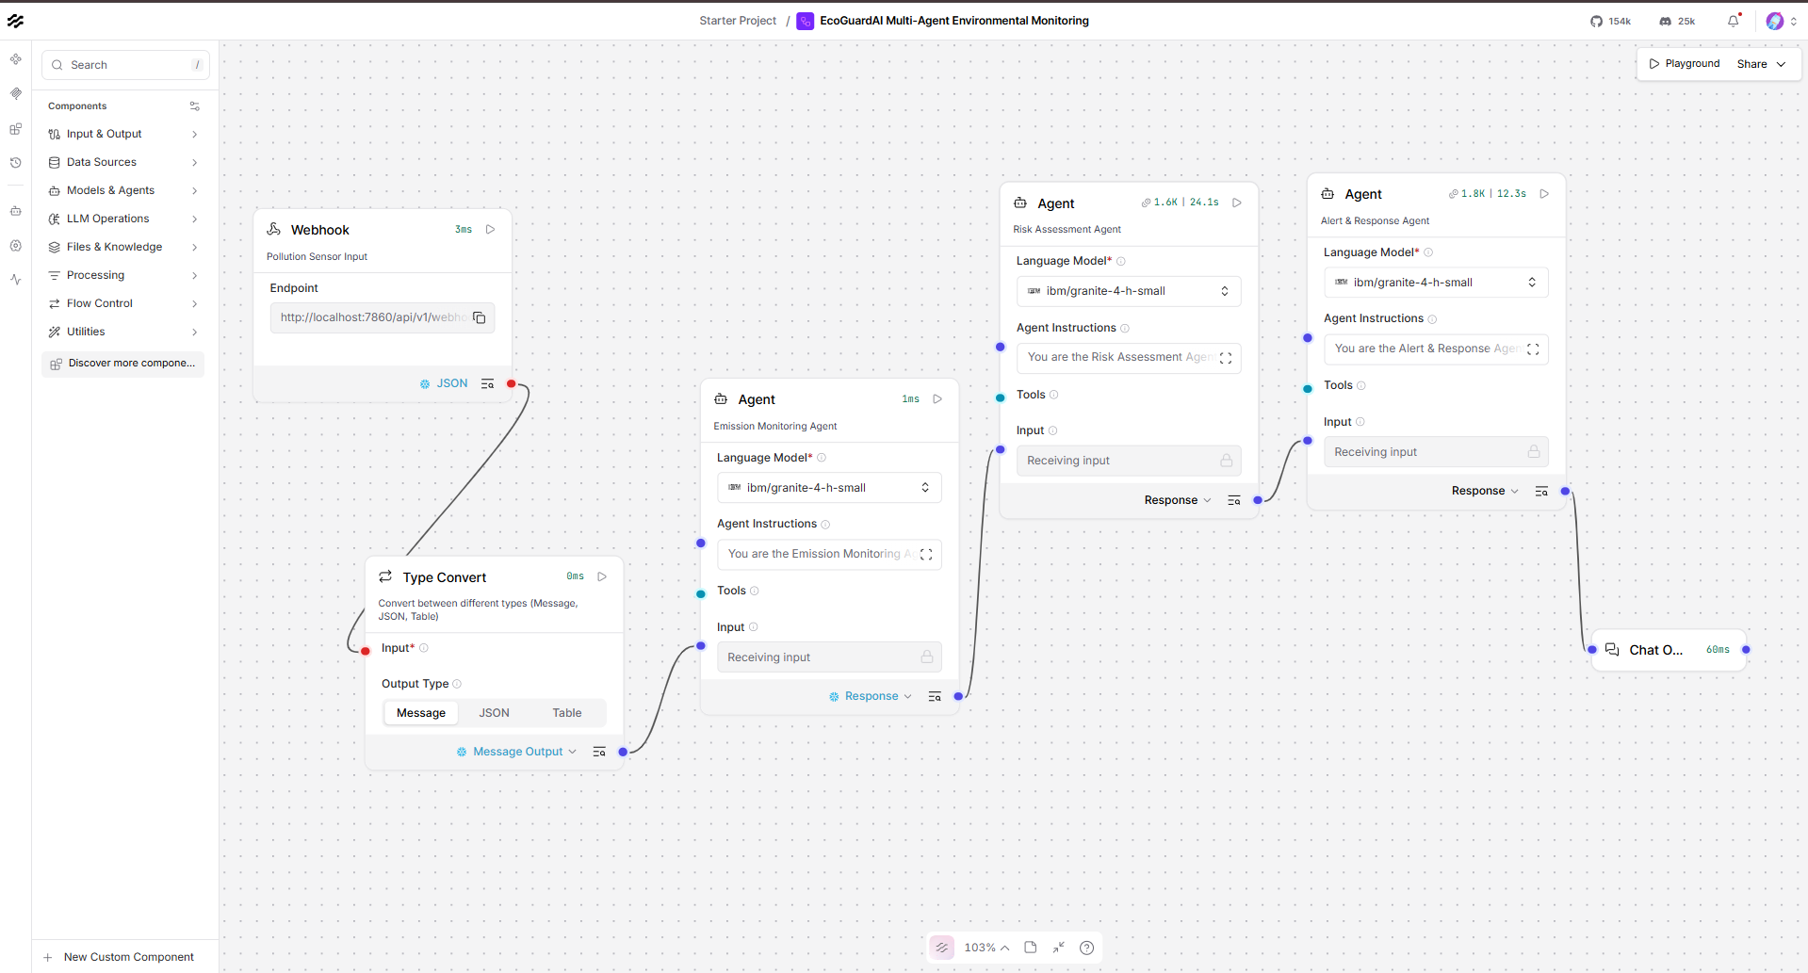
Langflow workflow -

Slide 8
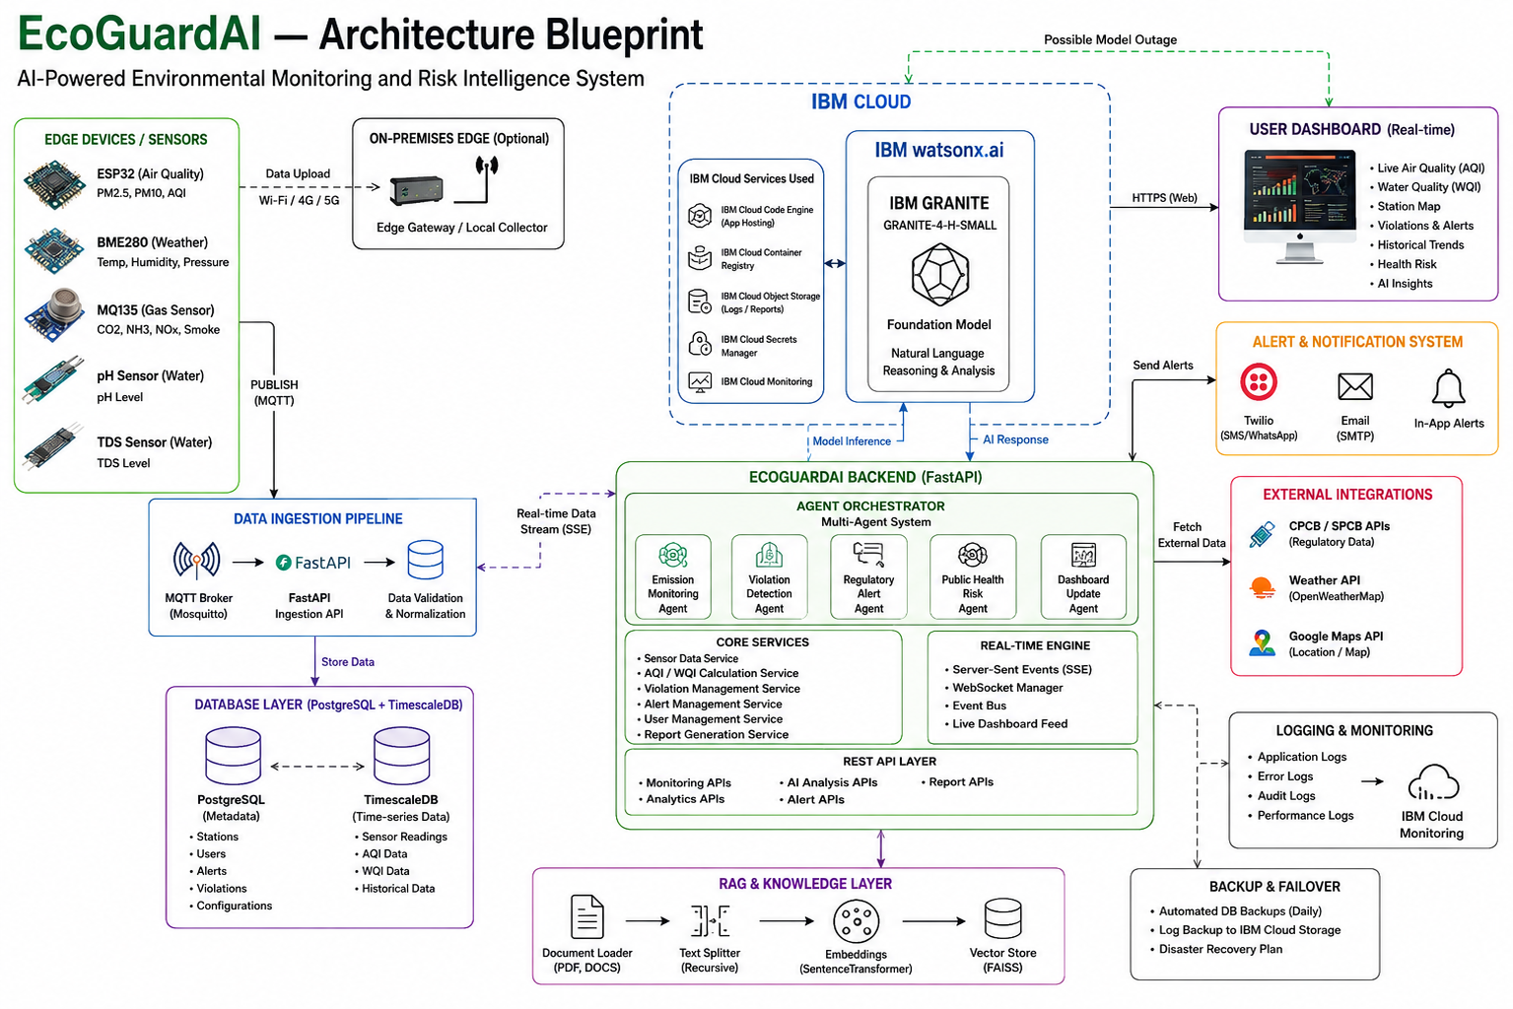

Slide 9

Role of Agentic AI in the solution
Agentic AI makes EcoGuardAI an intelligent and autonomous pollution-monitoring platform powered by IBM watsonx.ai and IBM Granite.
Emission Monitoring Agent → continuously monitors air & water pollution readings.
Violation Detection Agent → identifies abnormal readings and pollution-limit violations.
Regulatory Alert Agent → prioritizes violations and generates alerts.
Public Health Risk Agent → evaluates pollution impact and provides safety guidance.
Dashboard Agent → aggregates live data and updates the monitoring dashboard.
IBM Granite → analyzes verified environmental data and generates reports, explanations, insights, and recommendations.
Real-time processing → continuously reacts to incoming sensor readings and new violations.
Multi-agent coordination → agents work together to move from detection to analysis and response.
Overall:
Sensor Data → Monitor → Analyze → Detect Violation → Assess Risk → Alert → AI Recommendation
This makes EcoGuardAI more than a dashboard—it becomes an AI-powered environmental decision-support system.

Slide 10
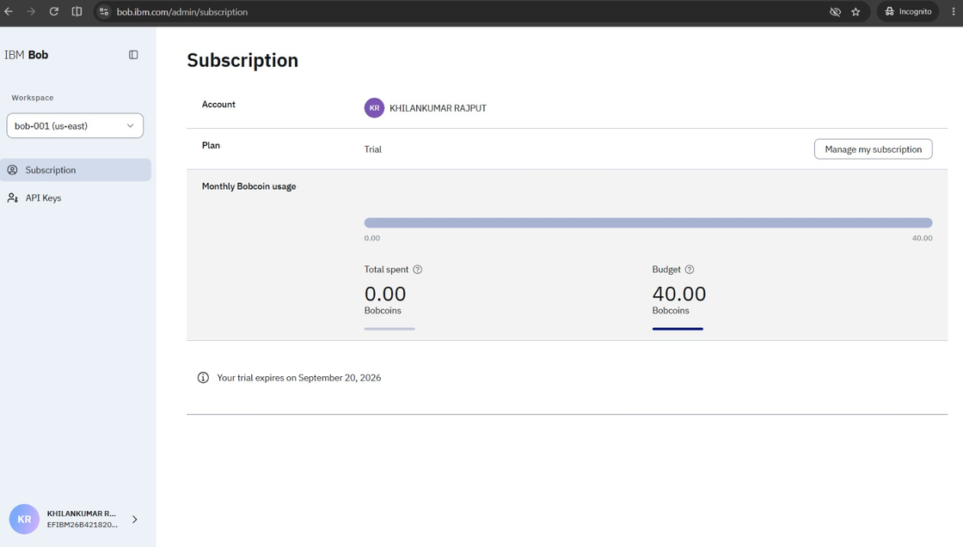
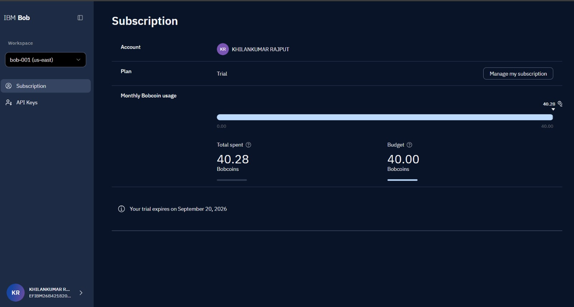
Before Prompt
After the Prompt
·
·

Slide 11
Novelty and Uniqueness
EcoGuardAI combines Agentic AI, real-time pollution monitoring, and IBM Granite into one intelligent environmental platform.
Multi-Agent AI – Specialized agents monitor, detect violations, assess risks, and generate alerts.
Real-Time Monitoring – Tracks live air and water quality across monitoring stations.
IBM Granite Intelligence – Generates reports, insights, explanations, and recommendations from monitoring data.
AI Violation Detection – Identifies abnormal pollution levels and classifies their severity.
Health Risk Analysis – Converts pollution levels into understandable public health guidance.
Regulatory Monitoring – Compares pollutant readings with applicable environmental limits.
Real-Time Alerts – Highlights critical pollution events for faster response.
Action-Oriented System – Goes beyond displaying data by helping users understand what happened, why it matters, and what action can be taken.
EcoGuardAI: Monitor → Detect → Analyze → Assess → Alert → Recommend

Slide 12
GitHub
Repository: EcoGaurdMONITOR
Working GitHub URL:
https://github.com/iamkk369/EcoGaurdMONITOR
Required Submission Files:
• app.json
• Problem Statement PDF
• Project Presentation PPTX
• Complete project source code & documentation
Repository: Public • Source Code • Documentation
• Submission Materials

Slide 13
Future Scope
Real IoT Sensor Integration — Connect real industrial air and water quality sensors for continuous, station-level pollution monitoring and reliable field data collection.
Historical & Predictive Analytics — Store long-term environmental data to identify pollution trends, recurring violations, and potential future risk conditions.
Advanced IBM Granite AI — Expand IBM Granite with watsonx.ai to generate deeper environmental analysis, violation reports, and context-aware recommendations.
RAG-Based Environmental Knowledge — Integrate verified CPCB/GPCB regulations, pollution standards, and environmental guidelines to provide more accurate and explainable AI insights.
Langflow Agent Orchestration — Implement visual workflows to coordinate monitoring, violation detection, regulatory alerts, health-risk assessment, and AI agents.
Automated Regulatory Alerts — Extend the alert system with secure email, SMS, WhatsApp, or official notification channels for high and critical violations.
IBM Cloud Deployment & Scalability — Deploy the platform on IBM Cloud with scalable infrastructure, secure data management, and reliable real-time monitoring.
Multi-Region Environmental Monitoring — Expand EcoGaurdMONITOR beyond the initial Gujarat industrial areas to other industrial regions and support larger environmental monitoring networks.
·

Slide 14
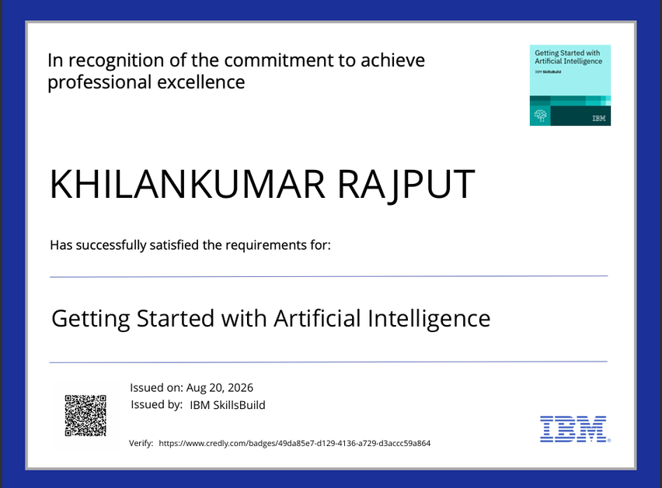
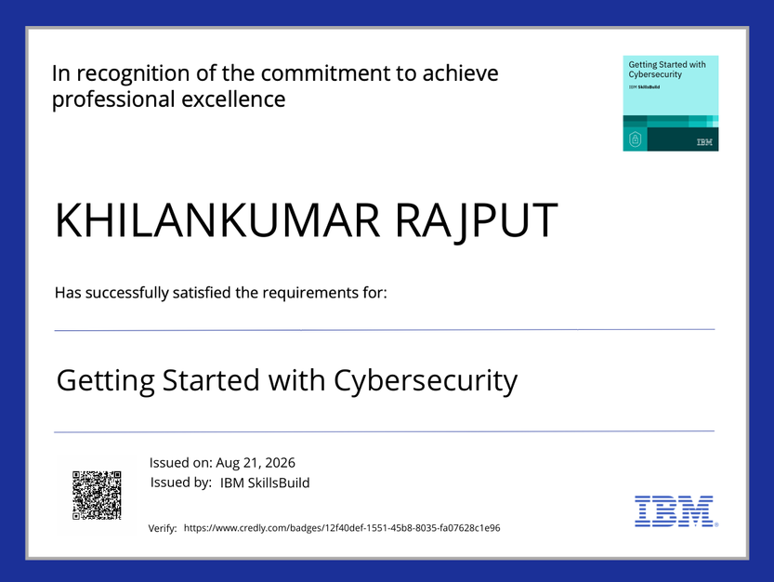
Certificates Earned:

Slide 15
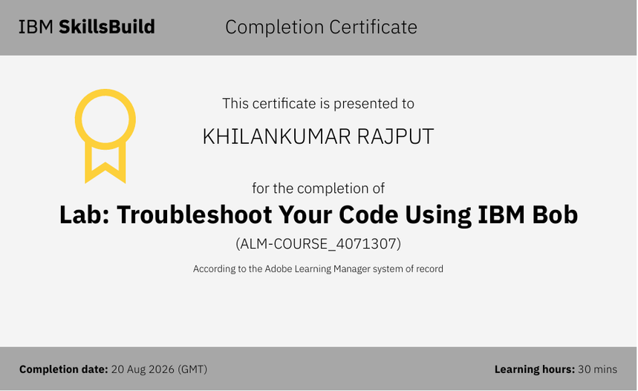
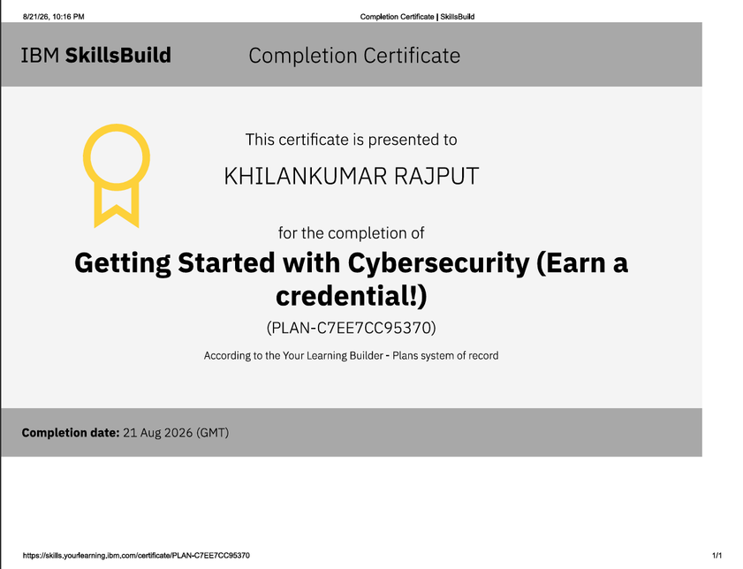
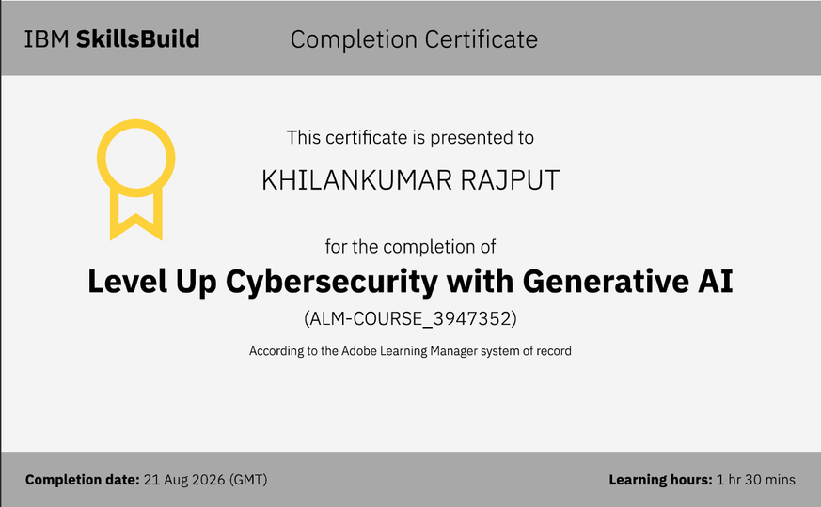
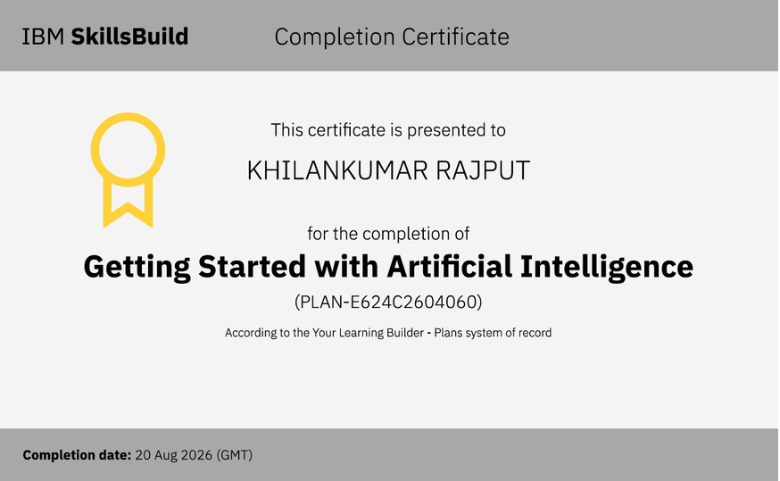
Certificates Earned:​

Slide 16


